Slide 1
Heuristic Functions

Slide 2
Heuristic Functions
A Heuristic is a function that, when applied to a state, returns a number that is an estimate of the merit of the state, with respect to the goal.
In other words, the heuristic tells approximately how far the state is from the goal state*.
Note the term “approximately”. Heuristics might underestimate or overestimate the merit of a state.
But for reasons which we will see, heuristics that only underestimate are very desirable, and are called admissible.
*i.e Smaller numbers are better

Slide 3

Heuristic Functions
To shed light on the nature of heuristics in general, consider Heuristics for 8-puzzle
Slide tiles vertically or horizontally into the empty space until the configuration matches the goal configuration

Slide 4
Heuristic Functions
The average solution cost for a randomly generated 8-puzzle is about 22 steps
  Average solution cost = 22 steps
The average branching factor is about 3
  Empty tile in middle 4 possible moves;
  In a corner, (7, 4, 8, 1 in Start state) there are 2 moves;
  Along an edge (positions 2, 5, 3, 6 in Start state) 3 moves;
  So, an exhaustive search to depth 22 would look at about 3²² states = 3.1*10¹⁰ states (where 3 is branching factor)

Slide 5
Heuristic Functions
  By keeping track of repeated states, we could cut down this factor by about 1, 70, 000
  Because it is known that there are only 9!/2 = 1, 81, 440 distinct states that are reachable
  This is a manageable number, but for 15-puzzle is roughly 10¹³ states
  So, a good heuristic function is needed

Slide 6
Heuristic Functions
To find the shortest solutions by using A*, a heuristic function is needed with following property
The heuristic function should never over estimate the number of steps to the goal
Two commonly used candidates:

Slide 7
Heuristic Functions
h1=the number of misplaced tiles
h2=the sum of the Manhattan distances of the tiles from their goal positions

Slide 8
Heuristics for 8-puzzle I
1
2
3
Current State
4
5
6
7
8
1
2
3
The number of misplaced tiles (not including the blank)
1
2
3
4
5
6
4
5
6
1
2
3
7
8
Goal State
7
8
4
5
6
7
8
N
N
N
In this case, only “8” is misplaced, so the heuristic function evaluates to 1.
In other words, the heuristic is telling us, that it thinks a solution might be available in just 1 more move.
Current state in bold and Goal state in grey
N
N
N
N
Y
Notation: h(n) h(current state) = 1

Slide 9
Heuristics for 8-puzzle II
3
2
8
3
3
Current State
2 squares
4
5
6
7
1
The Manhattan Distance (not including the blank)
8
1
2
3
Goal State
3 squares
4
5
6
8
7
8
1
In this case, only the “3”, “8” and “1” tiles are misplaced, by 2, 3, and 3 squares respectively, so the heuristic function evaluates to 8.
In other words, the heuristic is telling us, that it thinks a solution is available in just 8 more moves.
3 squares
1
Total 8
Notation: h(n) h(current state) = 8

Slide 10
Admissible heuristics
Ex1: for the 8-puzzle:
h₁(n) = number of misplaced tiles
h₂(n) = total Manhattan distance
(i.e., no. of squares from desired location of each tile)
h₁(S) = ?
h₂(S) = ?

Slide 11
Admissible heuristics
Ex1: for the 8-puzzle:
h₂(n) = total Manhattan distance
(i.e., no. of squares from desired location of each tile)
h₁(S) = ? 8
h₂(S) = ? 3+1+2+2+2+3+3+2 (sequentially starting from location 1 to location 8 on Start state ) = 18
h1(n) = number of misplaced tiles

Slide 12
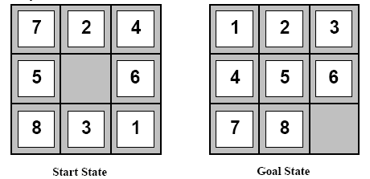
Heuristic Functions
Ex2: (The goal state is changed now)
h1 = ?
h2 = ?

Slide 13
Heuristic Functions
Ex2:
h1 = 6
h2 = 4+0+3+3+1+0+2+1 = 14

Slide 14
Heuristic Function
Ex3: 8-puzzle
  True solution cost = 26 steps
h1(N) = ? number of misplaced tiles
= ? admissible
h2(N) = sum of the distances of every tile to its goal position
= ?
= ? admissible
5
8
1
2
3
4
2
1
4
5
6
7
3
6
7
8
N
goal

Slide 15
Heuristic Function
Ex3: 8-puzzle
  True solution cost = 26 steps
h1(N) = number of misplaced tiles
= 6 is admissible
h2(N) = sum of the distances of every tile to its goal position
= 2 + 3 + 0 + 1 + 3 + 0 + 3 + 1
= 13 is admissible
Both do not over estimate the true solution cost which is 26
5
8
1
2
3
4
2
1
4
5
6
7
3
6
7
8
N
goal

Slide 16
Non admissible heuristic function
Ex3: New heuristic
5
8
1
2
3
4
2
1
4
5
6
7
3
6
7
8
N
goal
h3(N) = (sum of distances of each tile to goal)
+ 3 x (sum of score functions for each tile)
= 49 is not admissible

Slide 17
Show the steps from Start state to goal state

Slide 18
Example: State space tree for 8-Puzzle
f(N) = g(N) + h(N)
with h(N) = number of misplaced tiles
3+3
1+5
2+3
3+4
5+2
0+4
3+2
4+1
goal
1+3
2+3
5+0
3+4
1+5
2+4

Slide 19
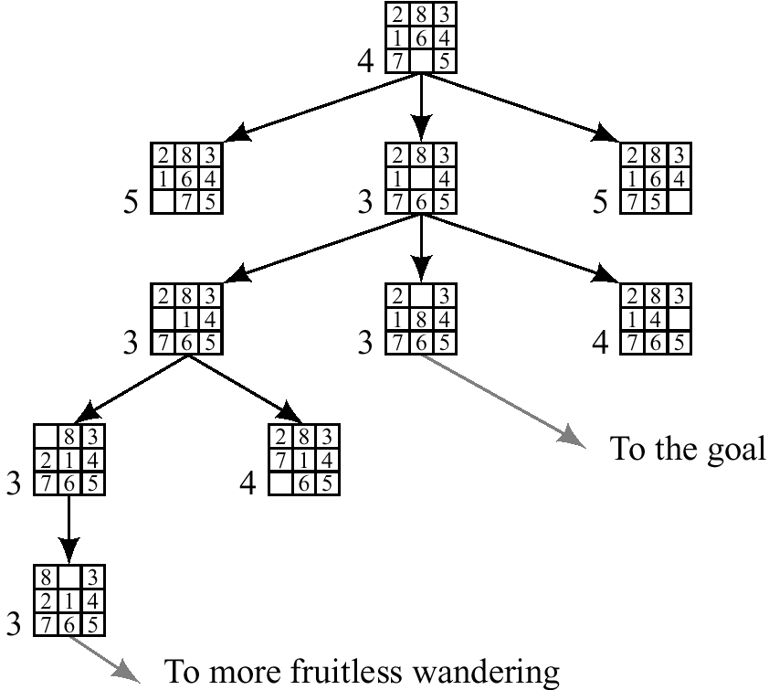
Best first (Greedy) search
h(n) = number of
misplaced tiles
f(n) = h(n)
Start state
2 | 8 | 3
1 | 6 | 4
7 |  | 5
Goal State
1 | 2 | 3
8 |  | 4
7 | 6 | 5

Slide 20
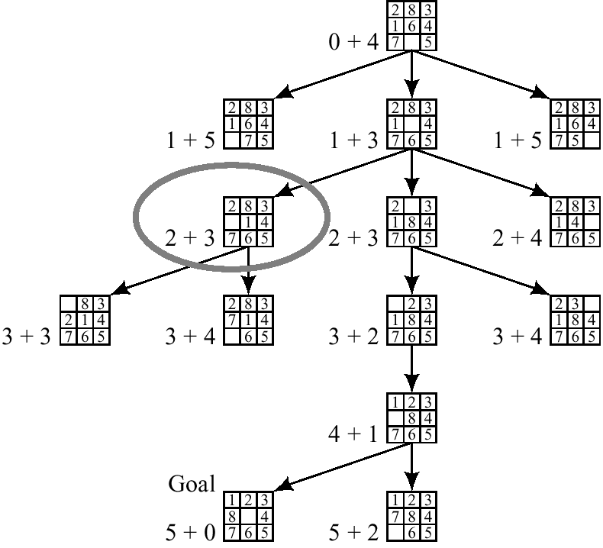
A* Search using Modified heuristic for 8-puzzle
h(n) = number of
misplaced tiles
f(n) = g(n) + h(n)
g(n) = depth of the node from the start node
Start state
2 | 8 | 3
1 | 6 | 4
7 |  | 5
Goal State
1 | 2 | 3
8 |  | 4
7 | 6 | 5

Slide 21
Effect of heuristic accuracy on Performance

Slide 22
Heuristic Functions
h1=the number of misplaced tiles
h2=the sum of the Manhattan distances of the tiles from their goal positions

Slide 23
Heuristics for 8-puzzle I
1
2
3
Current State
4
5
6
7
8
1
2
3
The number of misplaced tiles (not including the blank)
1
2
3
4
5
6
4
5
6
1
2
3
7
8
Goal State
7
8
4
5
6
7
8
N
N
N
In this case, only “8” is misplaced, so the heuristic function evaluates to 1.
In other words, the heuristic is telling us, that it thinks a solution might be available in just 1 more move.
Current state in bold and Goal state in grey
N
N
N
N
Y
Notation: h(n) h(current state) = 1

Slide 24
Heuristics for 8-puzzle II
3
2
8
3
3
Current State
2 spaces
4
5
6
7
1
The Manhattan Distance (not including the blank)
8
1
2
3
Goal State
3 spaces
4
5
6
8
7
8
1
In this case, only the “3”, “8” and “1” tiles are misplaced, by 2, 3, and 3 squares respectively, so the heuristic function evaluates to 8.
In other words, the heuristic is telling us, that it thinks a solution is available in just 8 more moves.
3 spaces
1
Total 8
Notation: h(n) h(current state) = 8

Slide 25
Effective branching factor
Effective branching factor b*
A way to characterize the quality of heuristic
  Let N be the total no. of nodes generated by A* for a particular problem
  Let d be the solution depth
  b* is the branching factor that a uniform tree of depth d would have in order to contain N+1 nodes.
  N is small if b* tends to 1
Ex: if A* finds a solution at depth 5 using 52 nodes, then b* is 1.92.
52 = 1 + 1.92 + (1.92)² + (1.92)³ + (1.92)⁴ + (1.92)⁵

Slide 26
Effective branching factor
Effective branching factor b*
  It can vary across problem instances
  But, measure is fairly constant for sufficiently hard problems.
So, experimental measurement of b* on a small set of problems can thus provide a good guide to the heuristic’s overall usefulness.
A well designed heuristic would have a value of b* close to 1 allowing fairly large problems to be solved

Slide 27
h1 or h2 is better ?
How to test?
1200 random problems were taken with solution lengths from 2 to 24 (100 for each even number)
Data are averaged over 100 instances of 8-puzzle, for various solution lengths
IDS and A* is used with both h1 and h2

Slide 28
h1 or h2 is better ?
How to test?
Table gives the average no. of nodes expanded by each strategy and b*
Typical search costs (average number of nodes expanded):
  d=12 IDS = 3,644,035 nodes A*(h1) = 227 nodes A*(h2) = 73 nodes
  d=24 IDS = too many nodes A*(h1) = 39,135 nodes A*(h2) = 1,641 nodes

Slide 29
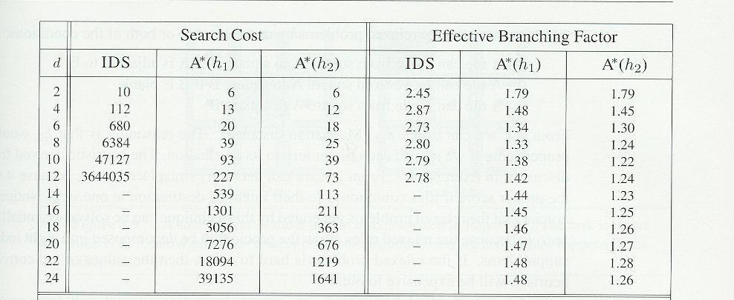
Comparison of search costs and b* for IDS and A* with h1 and h2
Note: Results suggest that h2 is better than h1
Also suggests that A* is better
On solution length 14, A* with h2 is 30, 000 times more efficient than uninformed IDS

Slide 30
Why h2 is better?
From these results it is obvious that h₂ is the better heuristic
As it results in less nodes being expanded.
But, why is this the case?
  An obvious reason why more nodes are expanded is the branching factor.
  If the branching factor is high then more nodes will be expanded.
Therefore, one way to measure the quality of a heuristic function is to find out its average branching factor.
We can see from Table that A* using h₂ has a lower effective branching factor and thus h₂ is a better heuristic than h₁

Slide 31
Effect of heuristic accuracy on Performance
Is h2 always better than h1?
From the definition of heuristics h1 and h2
  for any node n, it is easy to see that h2(n) >= h1(n)
So, we say that h2 dominates h1
If h2(n) >= h1(n) for all n (both admissible) then h2(n) dominates h1(n).
Is domination translating into efficiency (is domination better for the search)?

Slide 32
Domination
Is domination translate into efficiency (is domination better for the search)?
A* using h2 will never expand more nodes than A* using h1
Why?
It is known that every node with f(n) < C* will surely be expanded by A*
This is the same as saying that every node with h(n) < C* - g(n) will surely be expanded by A*
But, because h2 is at least as big as h1 for all nodes, every node that is surely expanded by A*search with h2 will also surely be expanded by A* search with h1
h1 might also cause other nodes to be expanded as well

Slide 33
Domination
So, it is better to use a heuristic function with higher values provided
  The heuristic does not over estimate
  The computation time for heuristic is not too large

Slide 34
Inventing admissible heuristic functions

Slide 35
Inventing admissible heuristic functions
So far, we know that both h1 ( misplaced tiles) and h2 ( Manhattan distance) are good heuristics for 8-puzzle
We also know that h2 is better
How might one have come up with h2?
Is it possible to invent such a heuristic mechanically?

Slide 36
Designing heuristics
Relaxing the problem
Precomputing solution costs of subproblems and storing them in a pattern database
(not in syllabus)
3. Learning from experience with the problem class

Slide 37
1. Relaxing the problem

Slide 38
Inventing Heuristics Automatically
How did we
  find h1 and h2 for the 8-puzzle?
  verify admissibility?
One approach is to think of an easier problem
Hypothetical answer:
  Heuristic are generated from relaxed problems
  Hypothesis: relaxed problems are easier to solve
Relax the game
In relaxed models the search space has more operators, or more directed arcs

Slide 39
Inventing Heuristics automatically
How can we invent admissible heuristics in general?
  look at “relaxed” problem where constraints are removed
    Ex1: Romania routing problem: we can move in straight lines between cities
    Ex2: automated Taxi Driver: the agent can move straight
    Ex3: Robot: the agent can move through walls
    Ex4: 8puzzle: (1) tiles can move anywhere (2) tiles can move to any adjacent square

Slide 40
Example 1
For route planning, what is a relaxed problem?
  Relax requirement that car stay on road
  Straight Line Distance becomes optimal cost
Cost of optimal solution to relaxed problem ≤ cost of optimal solution for original problem
The cost of an optimal solution to a relaxed problem is an admissible heuristic for the original problem

Slide 41
Inventing Heuristics Automatically
Example: 8 puzzle:
  A tile can be moved from A to B if
    A is horizontally or vertically adjacent to B and
    B is blank
We can generate relaxed problems by removing one or more of the conditions
    A tile can be moved from A to B if A is adjacent to B (ignore whether or not position is blank, retain adjacency)
    A tile can be moved from A to B if B is blank (ignore adjacency, retain blank)
    A tile can be moved from A to B (ignore both conditions)

Slide 42
Relaxed Problems
Relax the game
    A tile can be moved from A to B if A is adjacent to B (ignore whether or not position is blank, retain adjacency)
    A tile can be moved from A to B if B is blank (ignore adjacency, retain blank)
    A tile can be moved from A to B (ignore both conditions)
1 leads to Manhattan distance heuristic which is h2
  To solve the puzzle need to slide each tile into its final position
  Admissible
3 leads to misplaced tile heuristic which is h1
  To solve this problem need to move each tile into its final position
  Number of moves = number of misplaced tiles
  Admissible

Slide 43
Relaxed Problems
A problem with fewer restrictions on the actions is called a relaxed problem
h1 and h2 are estimates of the remaining path length for the 8 puzzle
But, they are accurate path lengths for simplified versions of 8 puzzle
If the rules of the 8-puzzle are relaxed so that a tile can move anywhere (instead of only adjacent square), then h₁(n) gives the exact number of steps in the shortest solution
If the rules are relaxed so that a tile could move one square in any direction any adjacent square (even onto an occupied square), then h₂(n) gives the exact number of steps in the shortest solution

Slide 44
How h1 and h2 are invented?
Relaxed 3: Tile can move from any location A to any location B
Cost = h1= number of misplaced tiles
Relaxed 1: Tile can move from A to B if A is horizontally or vertically next to B (note: B does not have to be blank)
Cost = h2 = total Manhattan distance

Slide 45
Relaxed Problems
The cost of an optimal solution to a relaxed problem is an admissible heuristic for the original problem
  Cost of optimal solution to relaxed problem ≤ cost of optimal solution for original problem
The heuristic is admissible because the optimal solution in the original problem, by definition, also a solution in the relaxed problem
So, it is as expensive as the optimal solution in the relaxed problem
Because the derived heuristic is an exact cost for the relaxed problem, it must obey the triangle inequality and hence, consistent

Slide 46
Relaxed Problems
The relaxed problems generated by this technique can be solved essentially without search
Because the relaxed rules allow the problem to be decomposed into eight independent sub problems

Slide 47
Relaxed Problems
If the relaxed problem is hard to solve
  The values of the corresponding heuristic will be expensive to obtain
  Heuristics are not useful if they're as hard to solve as the original problem
Identify constraints which, when dropped, make the problem extremely easy to solve
A program called ABSOLVER can generate heuristics automatically from problem definitions using the “relaxed problem” method
  Can be a useful way to generate heuristics
  E.g., ABSOLVER (Prieditis, 1993) discovered the first useful heuristic for the Rubik’s cube puzzle

Slide 48
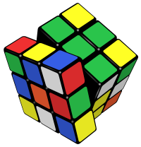
The Rubik’s Cube
The 3x3 cube is the most common of all Rubik’s cubes
It is a problem that requires the memory of algorithms, not skill!

Slide 49
Generating new heuristic functions
If a collection of admissible heuristics is available for a problem and
None of them dominates any of the others
Which one to choose?
Define h(n) = max{ h1(n), h2(n),……hk(n) }
The composite heuristic h(n) chooses the most accurate for the node n
  all h functions are admissible; composite heuristic is admissible
  h is consistent
  h dominates all of its component heuristics h1, h2, …

Slide 50
3. Learning from experience with the problem class

Slide 51
3. Learning Heuristics From Experience
h(n) is an estimate cost of the solution beginning from the state at node n
How can an agent construct such a function?
Learn from Experience! (third solution)

Slide 52
Learning Heuristics From Experience
Learn from Experience (Inductive learning)!
  Means solving lots of 8 puzzle
  Each example consists of a state from the solution path and the actual cost of the solution from that point
  Have the agent solve many instances of the problem and store the actual cost of h(n) at some state n
  From these examples, construct h(n) which estimates the solution costs for states that arise during search
  Ex: Such techniques are neural nets, decision trees (Chapter 18)

Slide 53
3. Learning Heuristics From Experience
Inductive learning methods work best when a feature of a state is supplied
Learn from the features of a state that are relevant to the solution, rather than the raw state description
  Generate “many” states with a given feature and determine the average distance
  Combine the information from multiple features
      h(n) = c(1)*x1(n) + c(2)*x2(n) + … where x1, x2, … are features

Slide 54
Learning Heuristics From Experience
Details
Ex: for 100 randomly generated 8 puzzle configurations
Get their actual solution costs
There can be several features x1(n), x2(n) etc.
Ex: For feature x1(n)
  We might observe that when x1(n) = 5, average solution cost = 14

Slide 55
Learning Heuristics From Experience
How to predict h(n) from x1(n) and x2(n) ?
Use linear combination
  h(n) = w₁ x1(n) + w₂ x2(n)

Slide 56
Learning Heuristics From Experience
Could try to learn a heuristic function based on “features”
  E.g., x1(n) = number of misplaced tiles
  E.g., x2(n) = number of goal-adjacent-pairs that are currently adjacent
  h(n) = w₁ x1(n) + w₂ x2(n)
    Weights could be learned again via repeated puzzle-solving
    Try to identify which features are predictive of path cost
    Weights could be adjusted to give the best fit to the actual data on solution costs

Slide 57
Summary - Designing heuristics
Relaxing the problem
Precomputing solution costs of subproblems and storing them in a pattern database
Learning from experience with the problem class

Slide 58


